Slide 1

Session 22
java.io Package

Slide 2
Review
The java.util package provides a miscellany of classes and interfaces such as Date, Calendar, BitSet besides providing the collection framework.
The classes Date, Calendar, Random and BitSet form the utility classes of the java.util package.
The class BitSet represents a dynamically sized set of bits.
The Collection interface provides common methods for all the collection classes and mechanisms to insert new objects into the collection.
The Collection interface is extended by List and Set interfaces respectively. Lists are similar to Sets except that Sets do not permit duplication of elements.

Slide 3
Review Contd…
The SortedSet interface extends Set and is used to store elements in ascending order.
The ArrayList class extends AbstractList and implements the List interface. An ArrayList object is a variable length array of object references and is used to create dynamic arrays.
The LinkedList class extends AbstractSequentialList and implements the List interface. It is used to create a linked-list data structure.
HashSet extends AbstractSet and implements the Set interface. It creates a collection that makes use of a hash table for storage.
Legacy classes and interfaces are the classes and interfaces that formed the collections framework in the earlier versions of Java.

Slide 4
Review Contd…
Dictionary,Hashtable,Properties,Stack ,Vector are the legacy classes. Dictionary class is obsolete and no longer used.
A map is an object, which stores data in the form of relationships between keys and values.
Map, Map.Entry, SortedMap are the Map interfaces while AbstractMap, HashMap, TreeMap and WeakHashMap are classes that implement Map Interface.
Pattern and Matcher are the two classes supporting regular expression processing. These two classes work together.
Pattern class is used to define a regular expression and Matcher class is used to match the pattern against another character sequence.
Timer and TimerTask are two classes that have been added in the java.util package. It allows a programmer to schedule a task for execution at future time.

Slide 5
Objectives
Discuss applets and I/O
Explain the concept of streams
Explain the standard input/output streams
Explain the classes InputStream and OutputStream
Describe the Byte array I/O
Discuss Filtered and Buffered I/O operations
Discuss the class RandomAccessFile
Describe reader and writer classes
Explain Serialization

Slide 6
Applets and File I/O
Java is commonly used to create applet-based programs intended for the Internet and the Web.
As they are downloaded on the client’s system, they can be the cause of potential attacks.
Hence applets are not allowed to work with file related operations such as reading or writing to a file.

Slide 7
Streams
A stream is a continuous group of data or a channel through which data travels from one point to another.
Input stream receives data from a source into a program.
Output stream sends data to a destination from the program.
Standard input/output stream in Java is represented by three fields of the System class : in, out and err.

Slide 8





Streams Contd…
When a stream is read or written, the other threads are blocked.
While reading or writing a stream, if an error occurs, an IOException is thrown.
Hence code that performs read / write operations are enclosed within try/ catch block.
Threads
Some Job
Threads
Some Job
IOException
Some Job
Stream read / write

Slide 9
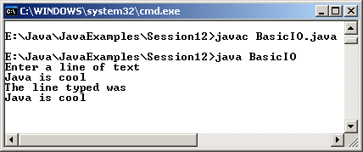
Example
class BasicIO
{
public static void main(String args[])
{
byte bytearr[] = new byte[255];
try
{
System.out.println("Enter a line of text");
System.in.read(bytearr,0,255);
System.out.println("The line typed was ");
String str = new String(bytearr,"Default");
System.out.println(str);
}
catch(Exception e)
{
System.out.println("Error occurred!");
}
}
}
Output

Slide 10
The java.io package
Two main categories of streams in Java :
  Byte Streams –
    These provide a way to handle byte oriented input/output operations.
    InputStream and OutputStream classes are at the top of their hierarchy.
  Character Streams –
    These provide a way to handle character oriented input/output operations.
    They make use of Unicode and can be internationalized.

Slide 11
Hierarchy of classes and interfaces
Object
File
FileDescriptor
DataInput
RandomAccessFile
DataOutput
InputStream
OutputStream
ByteArray
InputStream
FileInput
Stream
Filter
InputStream
FileOutput
Stream
Filter
OutputStream
ByteArray
OutputStream
DataInput
Stream
Buffered
InputStream
LineNumber
InputStream
PushBack
InputStream
DataOutput
Stream
Buffered
OutputStream
Print
Stream

Slide 12
DataInput Interface
It is used to read bytes from a binary stream and reconstruct data in any of the java primitive types.
Allows us to convert data that is in Java modified Unicode Transmission Format (UTF-8) to string form.
DataInput interface defines a number of methods including methods for reading Java primitive data types.

Slide 13
DataOutput Interface
Used to reconstruct data that is in any of the Java primitive types into a series of bytes and writes them onto a binary system.
Allows us to convert a String into Java modified UTF-8 format and write it into a stream.
All methods under DataOutput interface throw an IOException in case of an error.

Slide 14
InputStream class
An abstract class that defines how data is received.
The basic purpose of this class is to read data from an input stream.

Slide 15
FileInputStream
Used to read input from a file in the form of a stream.
Commonly used constructors of this class :
  FileInputStream(String filename) throws FileNotFoundException: Creates an InputStream that we can use to read bytes from a file.
  FileInputStream(File name) throws FileNotFoundException: Creates an input stream that we can use to read bytes from a file where name is a File object.

Slide 16
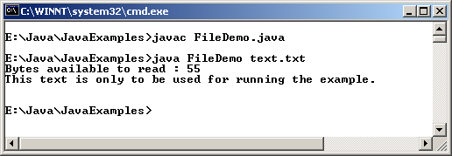
Example
import java.io.*;
class FileDemo
{
public static void main(String args[]) throws Exception
{
int size;
InputStream f = new FileInputStream(args[0]);
System.out.println("Bytes available to read : " + (size =
f.available()));
char str[] = new char[200];
for(int count = 0;count < size;count++)
{
str[count] = ((char)f.read());
System.out.print(str[count]);
}
System.out.println("");
f.close();
}
}
Output

Slide 17
ByteArrayInputStream
Used to create an input stream using an array of bytes.
Its constructors are :
  ByteArrayInputStream(byte b[]): Creates a ByteArrayInputStream with b as the input source.
  ByteArrayInputStream(byte b[]), int start, int num): Creates a ByteArrayInputStream that begins with the character at start position and is num bytes long.

Slide 18
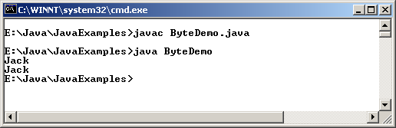
Example
import java.io.*;
class ByteDemo
{
public static void main (String []args)
{
String str = "Jack and Jill went up the hill";
byte[] b = str.getBytes();
ByteArrayInputStream bais = new ByteArrayInputStream(b,0,4);
int ch;
while((ch = bais.read()) != -1)
System.out.print((char) ch);
System.out.println();
bais.reset(); //using reset ( ) method and again reading
ch = 0;
while((ch = bais.read()) != -1)
System.out.print((char) ch);
}
}
Output

Slide 19
OutputStream class
An abstract class that defines the way in which outputs are written to streams.
This class is used to write data to a stream.

Slide 20
FileOutputStream
This class is used to write output to a file stream.
Its constructors are :
  FileOutputStream(String filename) throws FileNotFoundException : Creates an OutputStream that we can use to write bytes to a file.
  FileOutputStream(File name) throws FileNotFoundException : Creates an OutputStream that we can use to write bytes to a file.
  FileOutputStream(String filename, boolean flag) throws FileNotFoundException : Creates an OutputStream that we can use to write bytes to a file. If flag is true, file is opened in append mode.

Slide 21
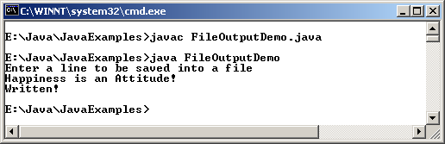
Example
import java.io.*;
class FileOutputDemo
{
public static void main(String args[])
{
byte b[] = new byte[80];
try
{
System.out.println("Enter a line to be saved into a file");
int bytes = System.in.read(b);
FileOutputStream fos = new FileOutputStream("xyz.txt");
fos.write(b,0,bytes);
System.out.println("Written!");
}
catch(IOException e)
{
System.out.println("Error creating file!");
}
}
}
Output

Slide 22
ByteArrayOutputStream
Used to create an output stream using a byte array as the destination.
This class defines two constructors.
  One takes an int argument which is used to set the output byte array to an initial size.
  Second does not take any argument and sets the output buffer to a default size.
Additional methods like toByteArray() and toString() convert the stream to a byte array and String object respectively.

Slide 23
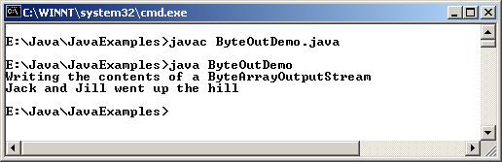
Example
import java.io.*;
class ByteOutDemo
{
public static void main (String []args) throws IOException
{
String str = "Jack and Jill went up the hill";
byte[] b = str.getBytes();
ByteArrayOutputStream b1 = new ByteArrayOutputStream();
b1.write(b);
System.out.println("Writing the contents of a ByteArrayOutputStream");
System.out.println(b1.toString());
}
}
Output

Slide 24
File
File class directly works with files on the file system.
All common file and directory operations are performed using the access methods provided by the File class.
Methods of this class allow the creating, deleting and renaming of files and directories.
File class is used whenever there is a need to work with files and directories on the file system.

Slide 25
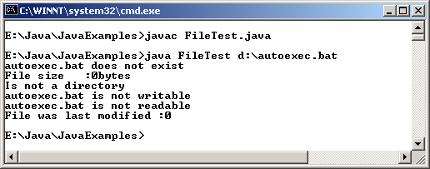
Example
class FileTest
{
static void show(String s)
{
System.out.println(s);
}
public static void main(String args[])
{
File f1 = new File(args[0]);
show(f1.getName()+(f1.exists()?" exists" : " does not exist"));
show ("File size :"+f1.length()+" bytes");
show ("Is"+(f1.isDirectory()?" a directory":"not a directory"));
show (f1.getName()+(f1.canWrite()? " is writable" : " is not writable"));
show(f1.getName()+(f1.canRead()? " is readable" : " is not readable"));
show("File was last modified :" + f1.lastModified());
}
}
Output

Slide 26
Filter Input and Output classes
These classes delegate filtering operations to their sub-classes such as BufferedInputStream or DataOutputStream.
  FilterInputStream: parent of all filtered input stream classes
    protected FilterInputStream(InputStream in)
  FilterOutputStream: parent of all filtered output stream classes
    public FilterOutputStream(OutputStream out)

Slide 27
Buffered I/O classes
A buffer is a temporary storage area for data.
By storing data in a buffer, we save time as we immediately get it from the buffer instead of going back to the original source of data.
Java uses buffered input and output to temporarily cache data, read from or written to a stream.
Filters operate on buffer, which is located between the program and destination of the buffered stream.

Slide 28
BufferedInputStream
This class defines two constructors. They are:
  BufferedInputStream(InputStream is): Creates a buffered input stream for the specified InputStream instance.
  BufferedInputStream(InputStream is, int size): Creates a buffered input stream of a given size for the specified InputStream instance.

Slide 29
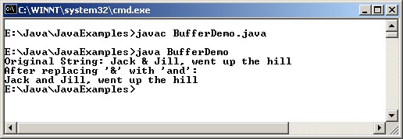
Example
import java.io.*;
class BufferDemo
{
public static void main(String []args) throws IOException
{
String str = "Jack & Jill, went up the hill";
System.out.println("Original String: "+str);
System.out.println("After replacing '&' with 'and': ");
byte buf[] = str.getBytes();
ByteArrayInputStream in = new ByteArrayInputStream(buf);
BufferedInputStream bis = new BufferedInputStream(in);
int c;
boolean flag = false;
while((c = bis.read()) != -1)
{
switch(c)
{
case '&':
if(!flag)
{
bis.mark(5);
flag = true;
}
else
{
flag = false;
}
break;
case ' ':
if (flag)
{
flag = false;
bis.reset();
System.out.print("and");
}
else
{
System.out.print ((char) c);
}
break;
default:
if(!flag)
System.out.print((char)c);
break;
}
}
}
}
Output

Slide 30
BufferedOutputStream
This class defines two constructors:
  BufferedOutputStream(OutputStream os): Creates a buffered output stream for the specified OutputStream instance with a buffer size of 512.
  BufferedOutputStream(OutputStream os, int size): Creates a buffered output stream of a given size for the specified OutputStream instance.

Slide 31
RandomAccessFile
This class does not extend either InputStream or OutputStream.
Instead implements the DataInput and DataOutput interfaces.
It supports reading/writing of all primitive types.
Data can be read or written to random locations within a file instead of continuous storage of information.
Constructors take “r”, “rw” or “rws” as a parameter for read only, read/write and read/write with every change.

Slide 32
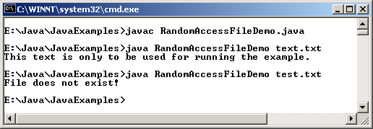
Example
import java.io.*;
class RandomAccessFileDemo
{
public static void main(String args[])
{
byte b;
try
{
RandomAccessFile f1 = new RandomAccessFile(args[0],"r");
long size = f1.length();
long fp = 0;
while(fp < size)
{
String s = f1.readLine();
System.out.println(s);
fp = f1.getFilePointer();
}
}
catch(IOException e)
{
System.out.println("File does not exist!");
}
}
}
Output

Slide 33
Character streams
They provide a way to handle character oriented input/output operations.
Supports Unicode and can be internationalized.
Reader and Writer are abstract classes at the top of the class hierarchy.

Slide 34
Reader class
Used for reading character streams and is abstract.
Some of the methods used are :
Method | Purpose
abstract void close() throws IOException | Closes the stream
int read() throws IOException | Reads one character
int read(char buf[]) throws IOException | Reads characters into an array
void reset() throws IOException | Resets the stream
long skip(long n) throws IOException | Skips n characters
boolean ready() throws IOException | Determines if the stream is ready to be run

Slide 35
Writer class
An abstract class that supports writing into streams
Some of the methods used are :
Method | Purpose
abstract void close() throws IOException | Closes the stream
abstract void flush( ) throws IOException | Flushes the stream
void write(char[] c) throws IOException | Writes the specified array of characters
abstract void write(char [] c, int offset, int n) throws IOException | Writes the specified length of characters from offset position in the array

Slide 36
PrintWriter class
It is a character based class that is useful for console output.
Provides support for Unicode characters.
Printed output is flushed and tested for any errors using checkError() method.
Supports printing primitive data types, character arrays, strings and objects.

Slide 37
Character Array Input / Output
CharArrayReader
CharArrayWriter
Supports input and output from memory buffers
Supports 8-bit character input and output
CharArrayWriter adds the methods to the ones provided by class Writer; some of these are:
Method | Purpose
void reset( ) | Resets the buffer
int size( ) | Returns the current size of the buffer
char [] toCharArray() | Returns the character array copy of the output buffer
void writeTo(Writer w) throws IOException | Writes the buffer to another output stream

Slide 38
Serialization
There are two streams in java.io: ObjectInputStream and ObjectOutputStream.
They are like any other input stream and output stream with the difference that they can read and write objects.
Serialization is the process of reading and writing objects to a byte stream.

Slide 39
ObjectInputStream
This class extends the InputStream class and implements the ObjectInput interface.
ObjectInput interface extends the DataInput interface and has methods that support object serialization.
ObjectInputStream is responsible for reading objects from a stream.

Slide 40
ObjectOutputStream
This class extends the OutputStream class and implements the ObjectOutput interface.
It writes object to the output stream.

Slide 41
Example
import java.io.*;
import java.util.*;
class TestClass
{
String str;
Date dt;
double db;
int i;
TestClass()
{}
TestClass( String s, Date d, double d1, int i1)
{
str = s;
dt = d;
db = d1;
i = i1;
}
public String toString()
{
return "name = "+ str + "date : " + dt +" income : " + db +" years of service : " +i;
}
}
class SerializationDemo
{
public static void main(String [] args)
{
try
{
TestClass t1 = new TestClass("hello ", new Date(), 500.75, 7);
System.out.println("the values are : " + t1);
FileOutputStream fos = new FileOutputStream("text1");
ObjectOutputStream out1 = new ObjectOutputStream(fos);
out1.writeObject(t1);
out1.flush();
out1.close();
}
catch(Exception e)
{
System.exit(0);
}

Slide 42
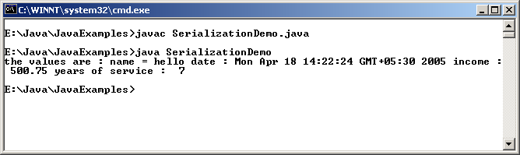
Example Contd…
try
{
TestClass test = new TestClass();
//System.out.println("the values are : " + t1);
FileInputStream fis = new FileInputStream("text1");
ObjectInputStream in1 = new ObjectInputStream(fis);
test = (TestClass)in1.readObject();
in1.close();
}
catch(Exception e)
{
System.exit(0);
}
}
}
Output

Slide 43
Summary
According to the sandbox theory, applets reside within a sandbox and are allowed to manipulate data only within the specified area on the hard disk
A stream is a path traveled by data in a program.
When a stream of data is being sent or received, we refer to it as writing and reading a stream respectively.
The standard input-output stream consists of System.out, System.in, and System.err streams.
InputStream is an abstract class that defines how data is received.
InputStream provides a number of methods for reading and taking streams of data as input.

Slide 44
Summary Contd…
The OutputStream class is also abstract. It defines the way in which output is written to streams.
ByteArrayInputStream creates an input stream from the memory buffer while ByteArrayOutputStream creates an output stream on a byte array.
Java supports file input and output with the help of File, FileDescriptor, FileInputStream and FileOutputStream classes.
File class directly works with files on the file system. The files are named using the file-naming conventions of the host operating system.
FileDescriptor class provides access to the file descriptors that are maintained by the operating system when files and directories are being accessed.

Slide 45
Summary Contd…
A buffer is a temporary storage area for data. Java uses buffered input and output to temporarily cache data read from or written to a stream.
The RandomAccessFile class provides the capability to perform I/O to specific locations within a file.
Character streams provide a way to handle character oriented input/output operations.
Reader and Writer classes are abstract classes that support reading and writing of Unicode character streams.
The CharArrayReader and CharArrayWriter classes are similar to ByteArrayInputStream and ByteArrayOutputStream in that they support input and output from memory buffers.
Serialization is the process of reading and writing objects to a byte stream.

